Slide 1
Fire safety

Slide 2
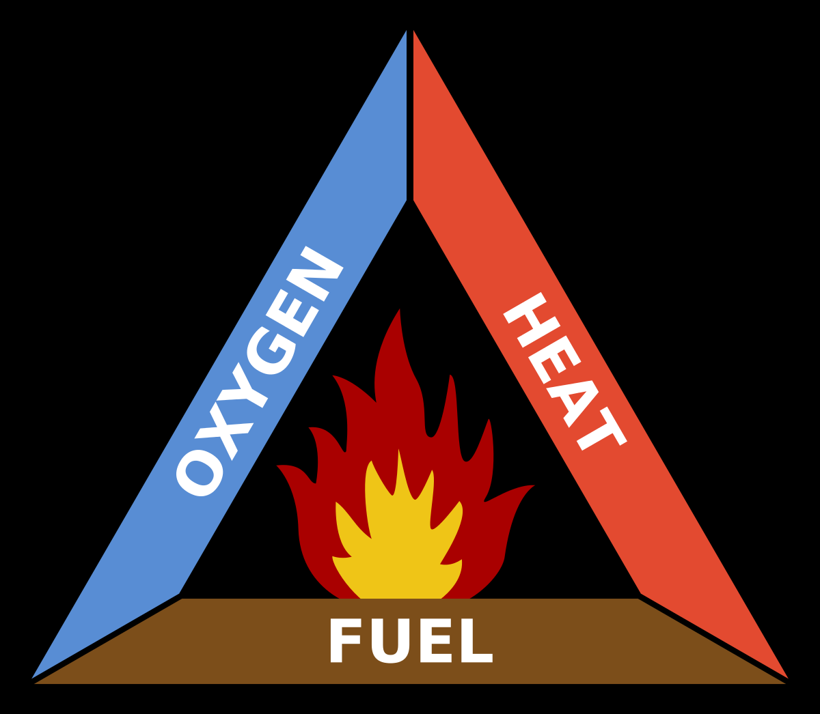

Slide 3
Fire :
Time, Secounds count
Smoke
Heat

Slide 4
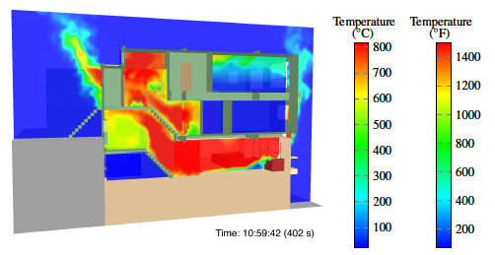

Slide 5
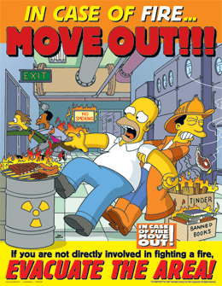

Slide 6
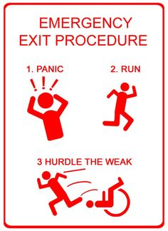
Panic
Panic during parade

Slide 7



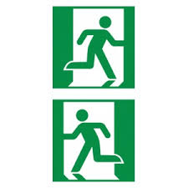


Way to Main exits
Way to additional exit

Slide 8


Phone for emergency call
Safe gathering place

Slide 9
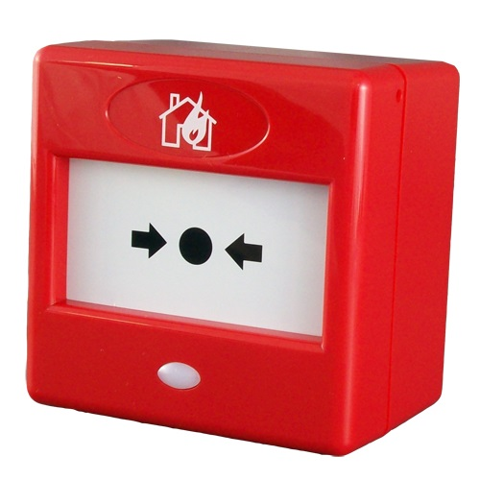

Alarm button

Slide 10


Fire safety tap. Atmospher
Fire extinguisher

Slide 11
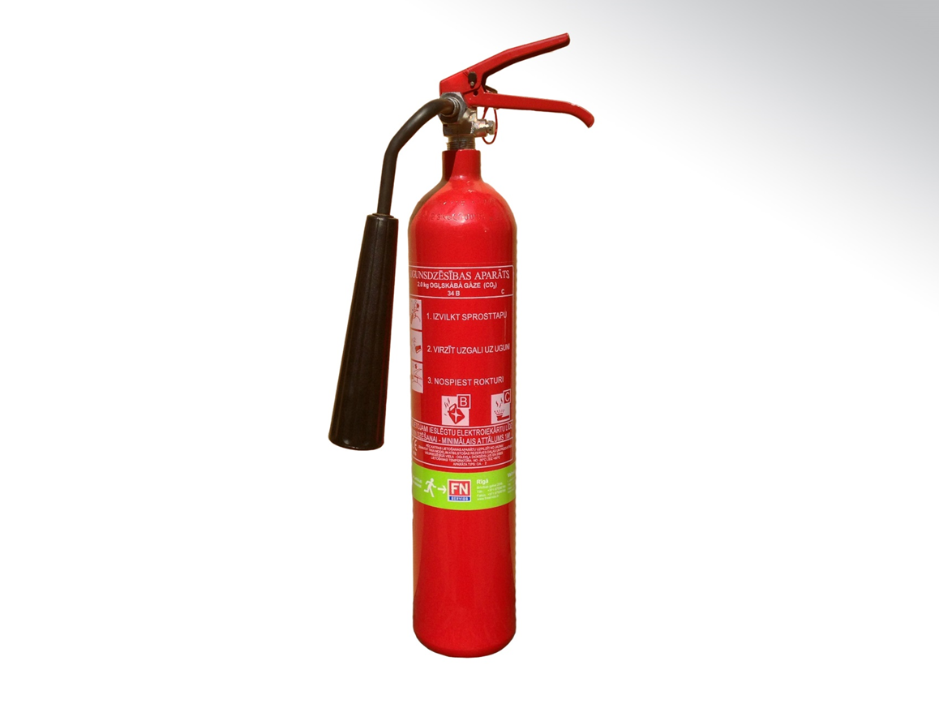
Carbon dioxide fire extinguisher
How not to use

Slide 12
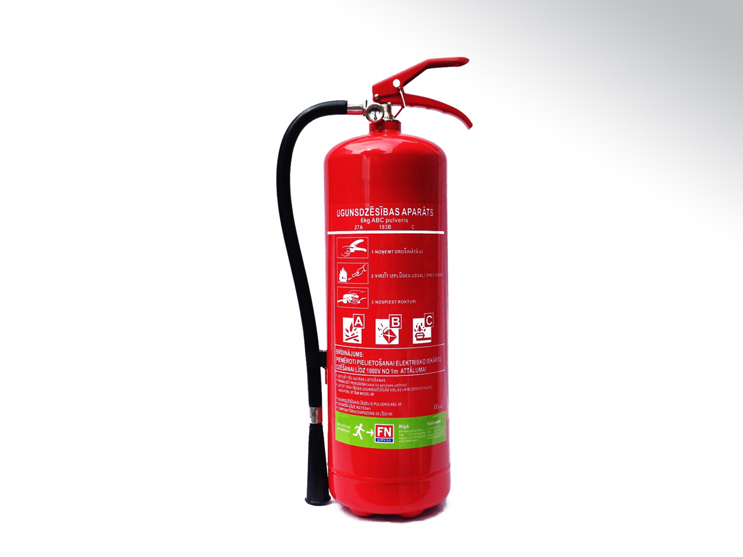
Powder fire extinguisher

Slide 13
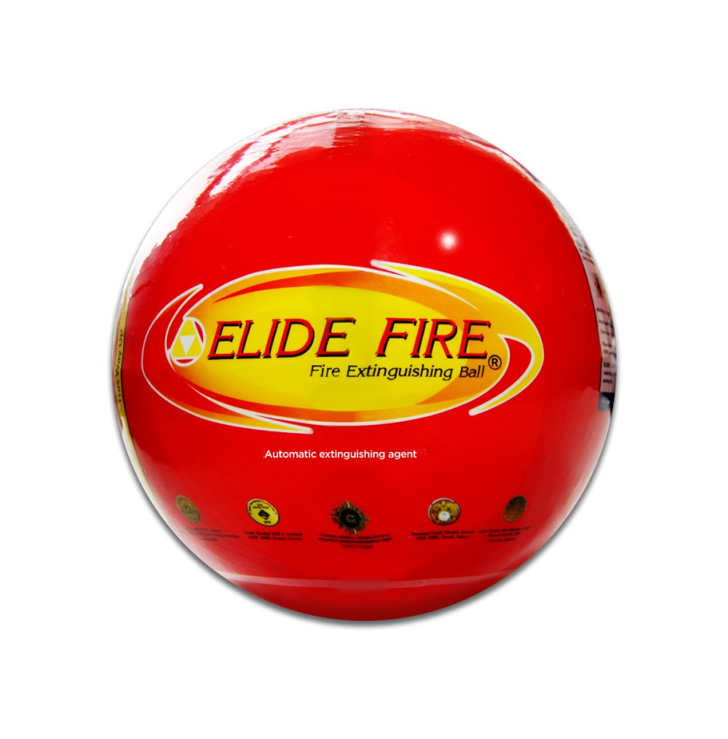
Fire Extinguishing Ball Extra tests

Slide 14
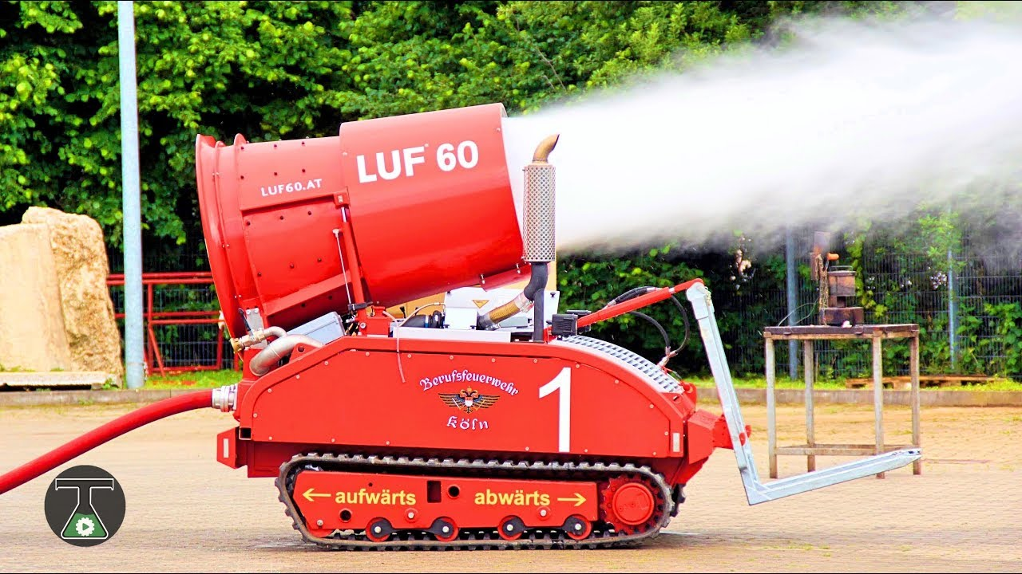
Another equipment Missiles for extinguish fire

Slide 15
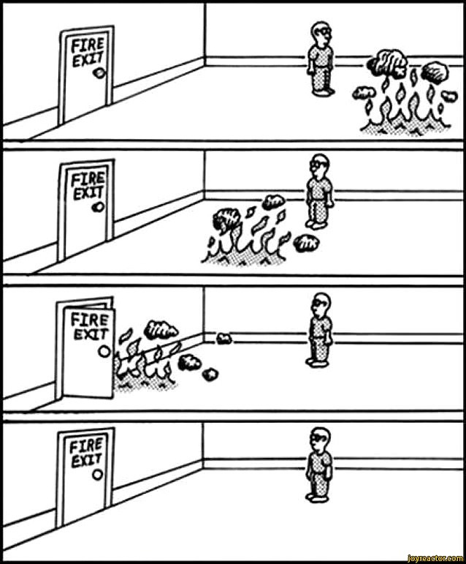
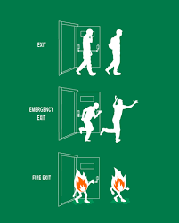

Slide 16
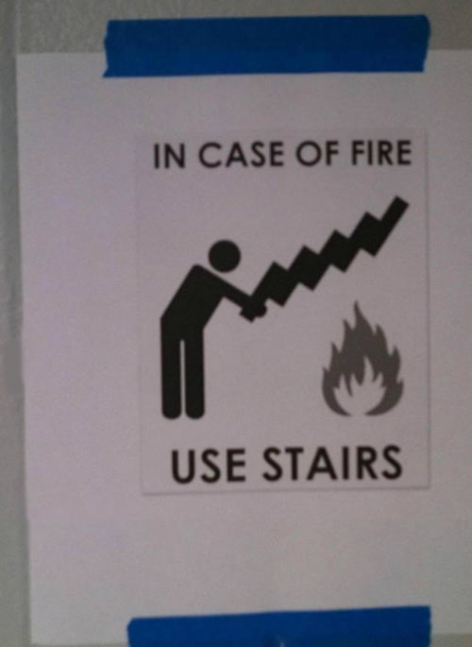
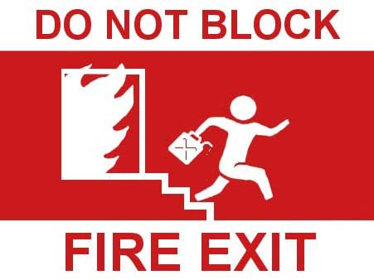

Slide 17
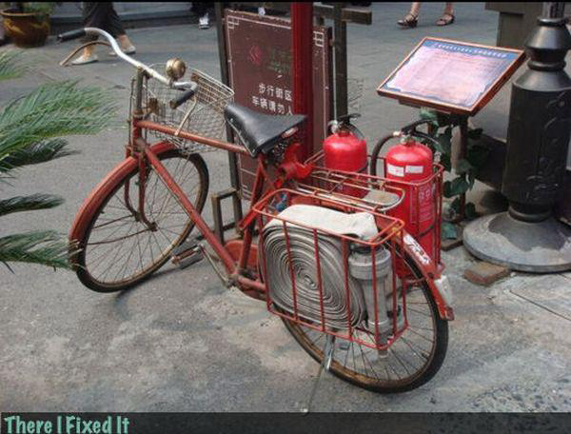

Slide 18
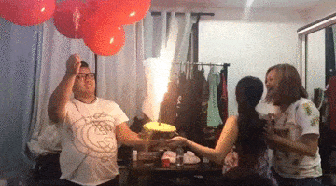

Slide 19
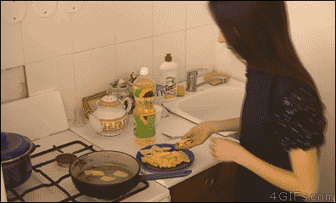
Oil & water

Slide 20
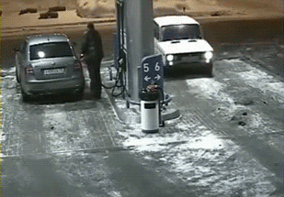

Slide 21
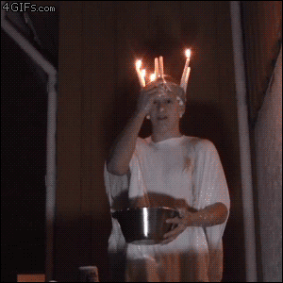

Slide 22
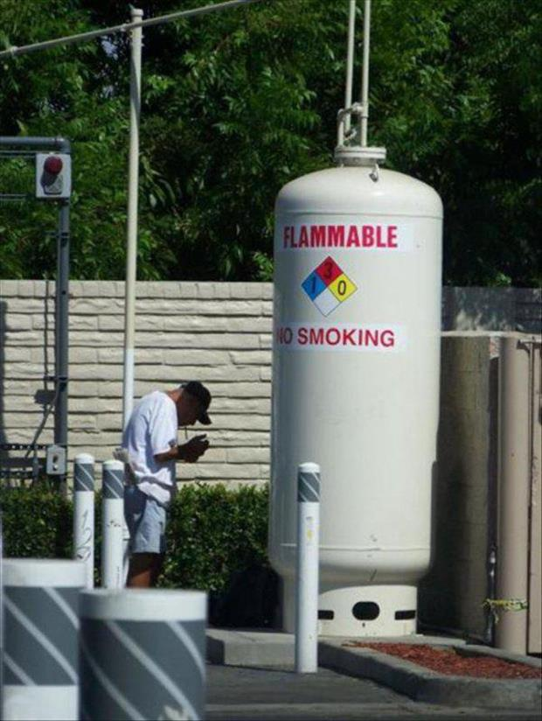
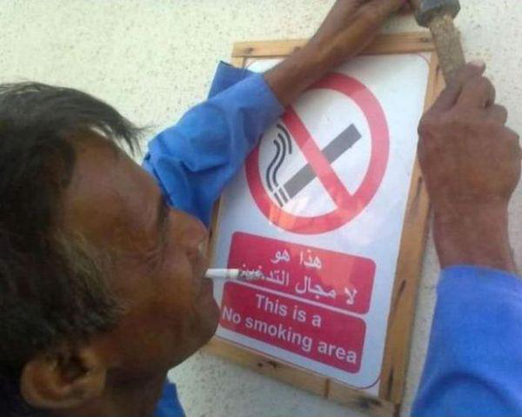

Slide 23
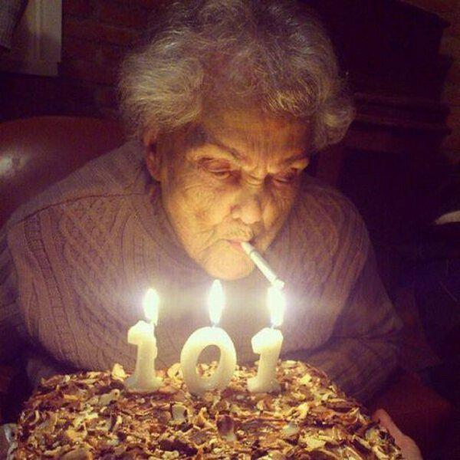

Slide 24

Don't forget!

Slide 25
The office fire drill

Slide 26
I HOPE YOU'LL NEVER NEED TO USE THIS KNOWLEDGE!!!

